Slide 1
ESG & Real Estate
Trends, Risks and the importance of “true energy performance”.

Slide 2
ESG & REAL ESTATE
ENVIRONMENTAL
Taking care of the planet
SOCIAL
Taking care of people
GOVERNANCE
Turning commitments into action
ESG measures will redefine how companies are valued in the future. This new paradigm will create winners and losers.

Slide 3
Agenda
Taxonomy Overview
Stranded Assets and Valuation
Immediate challenges
How are Ireland Performing?
ESG at Organisational and Asset Level
Summary

Slide 4
ESG – A noisy space
From this “sea of acronyms”, stakeholders must choose the best path to deliver value for their shareholders, whilst protecting the planet and
supporting communities
ESG is a complex field, with over 600 voluntary frameworks to choose from
These initiatives can be broken down into 3 core categories;
Legislative, Commercial and Ethical.

Slide 5
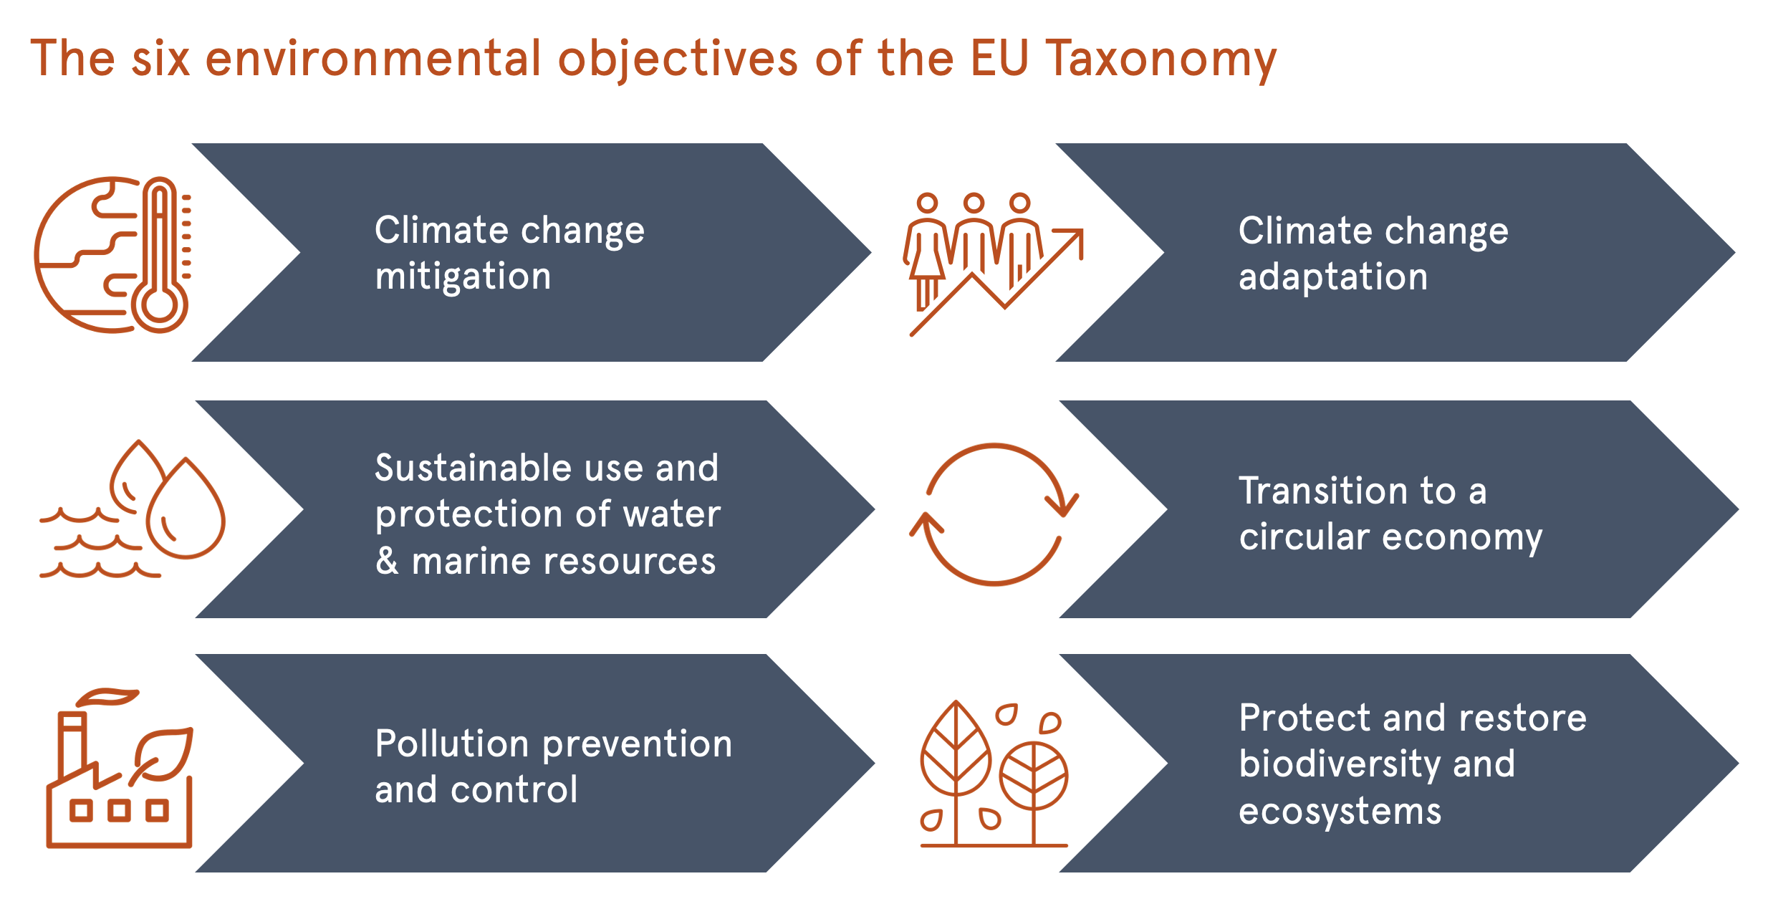
What is the EU Taxonomy?
The EU Taxonomy is a classification system for companies and investors to determine whether an economic activity is “environmentally sustainable”.
The Taxonomy Regulation covers the economic activities of several sectors which are collectively responsible for around 93.5% of greenhouse gas emissions within the EU.
In addition to the manufacturing industry, transport and storage, agriculture and the energy sector, these also include the construction and property industries.
For our sector, construction of new buildings, renovation of existing buildings and acquisition and ownership of buildings are the most relevant economic activities classified in the Taxonomy.
The Taxonomy includes technical screening criteria for each activity and is closely linked to non-financial disclosure requirements such as SFDR and NFRD
93.5% of GHGS

Slide 6
How does the EU Taxonomy impact on us?
As an example, in order for existing assets to be considered sustainable or aligned, they would need to be buildings within the top 15% in terms of energy performance on a national or regional scale.
For new construction there are a series of enhancements required to meet the definition of Taxonomy-aligned. In particular, a pathway towards Climate Mitigation presents requirements for reduced energy demand, increased renewables and a series of related improvements.
The move towards net zero will see new construction selecting materials and methods of construction with lower embodied carbon.
Renovation, deep retrofit and adaptation will become more attractive than traditional demolition and rebuild.
Smarter building systems will reduce operating carbon and clients will increase investment in renewables.
Climate risks (Acute and Chronic) will be factored into building design and renovation

Slide 7
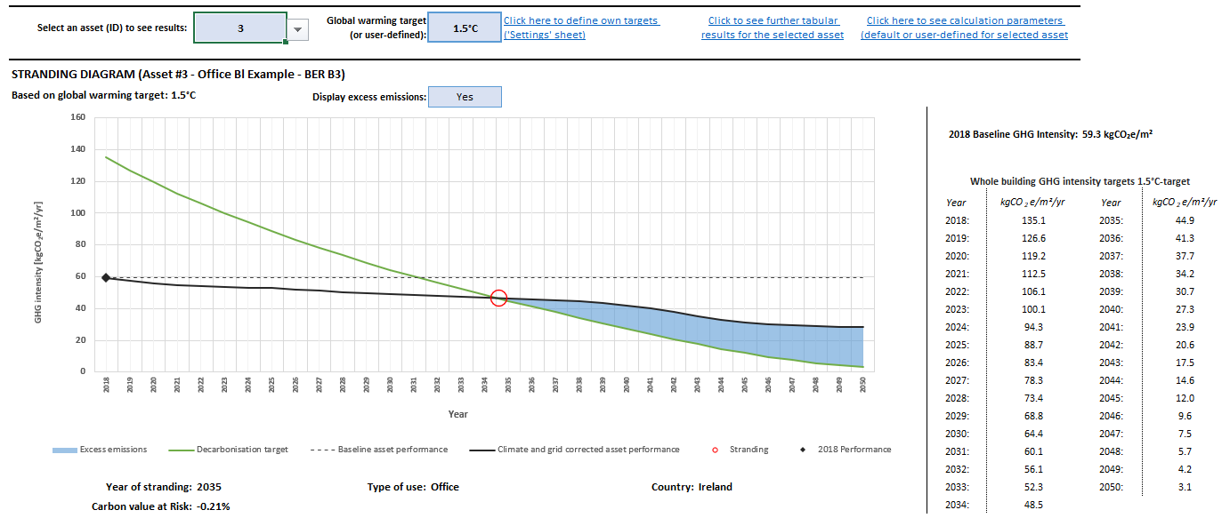
Stranded Assets - “True Performance” Matters

Slide 8
ESG & Valuations
MSCI Investment Insights 2021 Report states that
“Over 73% of those surveyed planned to significantly or moderately increase their investment allocation in ESG-friendly assets by the end of 2021 with a further 36 percent seeing the “social” aspect as a larger proportion of the mix by the end of2021.
RICS Sustainability Report published in Q2 2021 showed, as illustrated by the diagram below that;
“Globally, around half of respondents believe that green/sustainable buildings achieve a rent and a price premium over comparable non-green/sustainable buildings.
More than one-third believe that the rent and price premium stands at up to 10%; around 15% judge it to be higher still. Furthermore, over 30% of respondents suggest that, even if there is no rent or price premium, buildings not classed as green or sustainable are subject to a brown discount. ”
It stands to reason that ESG will play an increasing role in transactions given these projections.
73%
10%
30%

Slide 9
What are the immediate challenges?
The EU is facing a raft of legislative changes, the most notable (and most immediate of which is the EU Taxonomy)
Low-cost finance is increasingly being aligned with EU Taxonomy and “Green” assets.
“Brown” assets will certainly see an increased cost of capital going forward.
“Non-green” or “brown” assets are also less attractive to premium investors and tenants, impacting negatively on asset values.
As more and more green assets are produced, brown assets are likely to devalue at an increasing rate.
Draft Directive on Corporate Due Diligence and Corporate Accountability and EU Social Taxonomy are also on the horizon.
Local Transition Risk - Most countries have begun to introduce punitive penalties, where several EU nations have begun to introduce MEPS “burning platform” policies to drive compliance with COP21 targets.
“Energy-Performance Gaps”: Data from CIBSE tells us that most newly constructed assets will have a true energy performance which is between 20-40% less efficient than the “designed performance”.
Research indicates that insurers and underwriters are beginning to factor climate risk into insurance premiums and the likelihood is that insurance costs will increase for less sustainable buildings.

Slide 10
ESG at Market and Organisation Level

Slide 11
ESG STRATEGY – “LOOK BEFORE YOU LEAP”
Too many companies view ESG solely as an operational or tactical challenge, something that they must do to satisfy investors, funders and/or customers.
Whilst ESG does require a coherent operational framework in order to deliver results, it is not advisable to “leap to action” before first developing a meaningful ESG Strategy. Otherwise, companies may target the wrong initiatives and track the wrong KPIs.

Slide 12
So how are we performing?
Not very well....EUROPEAN FIRMS AND CLIMATE CHANGE 2020/2021 by EIB noted that;
Around 45% of EU firms report investments to address climate change
Ireland in the worst performer in Western and Northern Europe at 19%
We are second only to Greece at 18%.
Ireland also scored lowest in Western and Northern Europe on “% of firms investing in energy efficiency” and “share of firms total investment on energy efficiency measures.”
19%

Slide 13
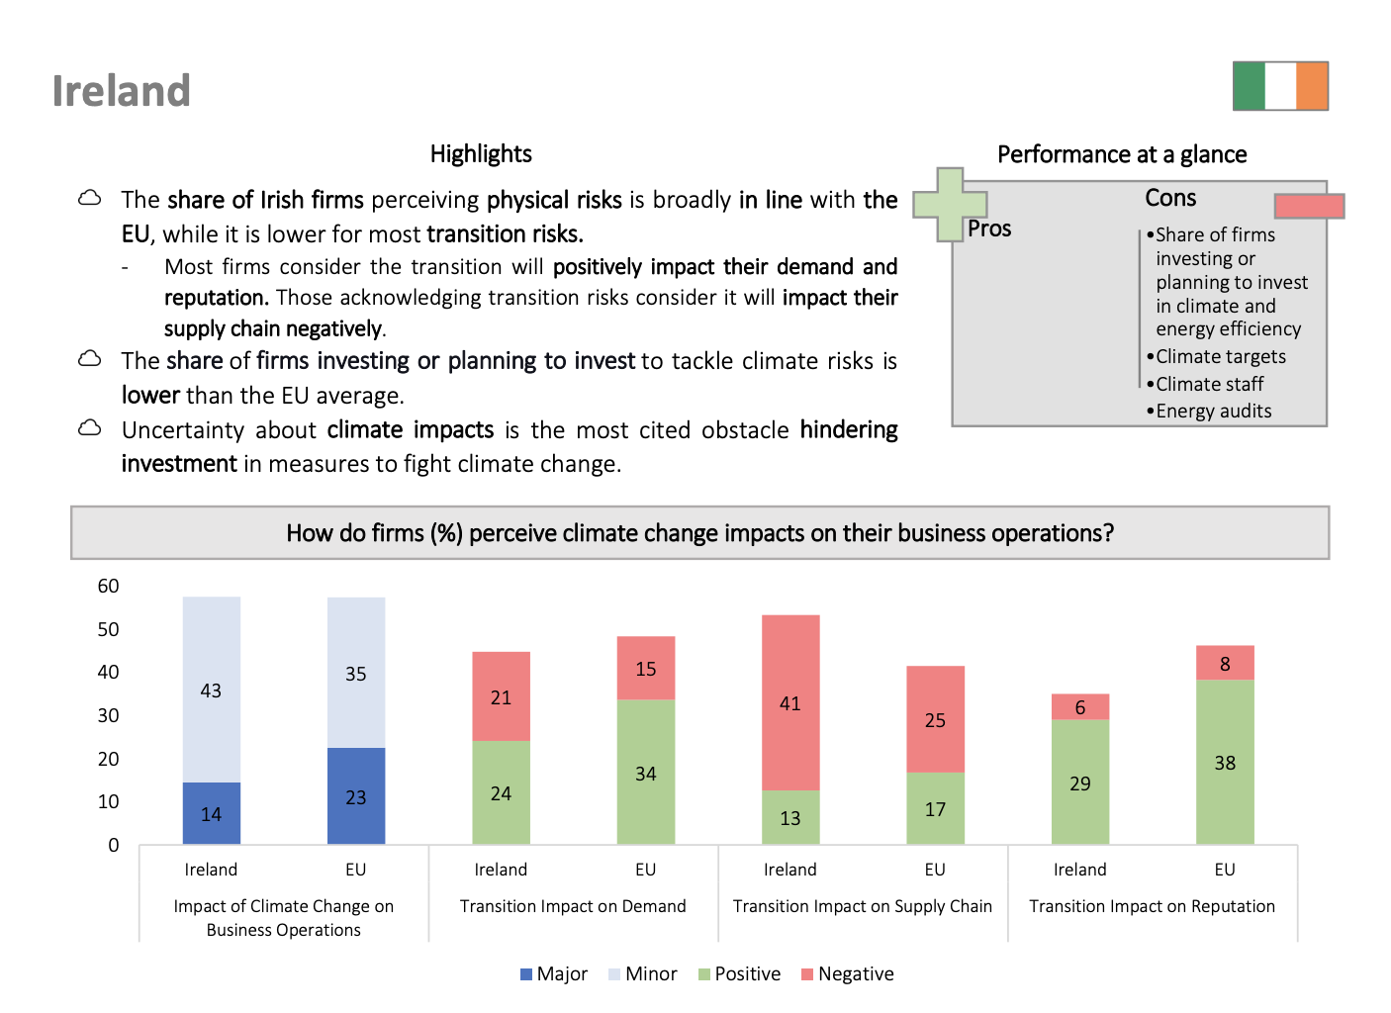

Slide 14
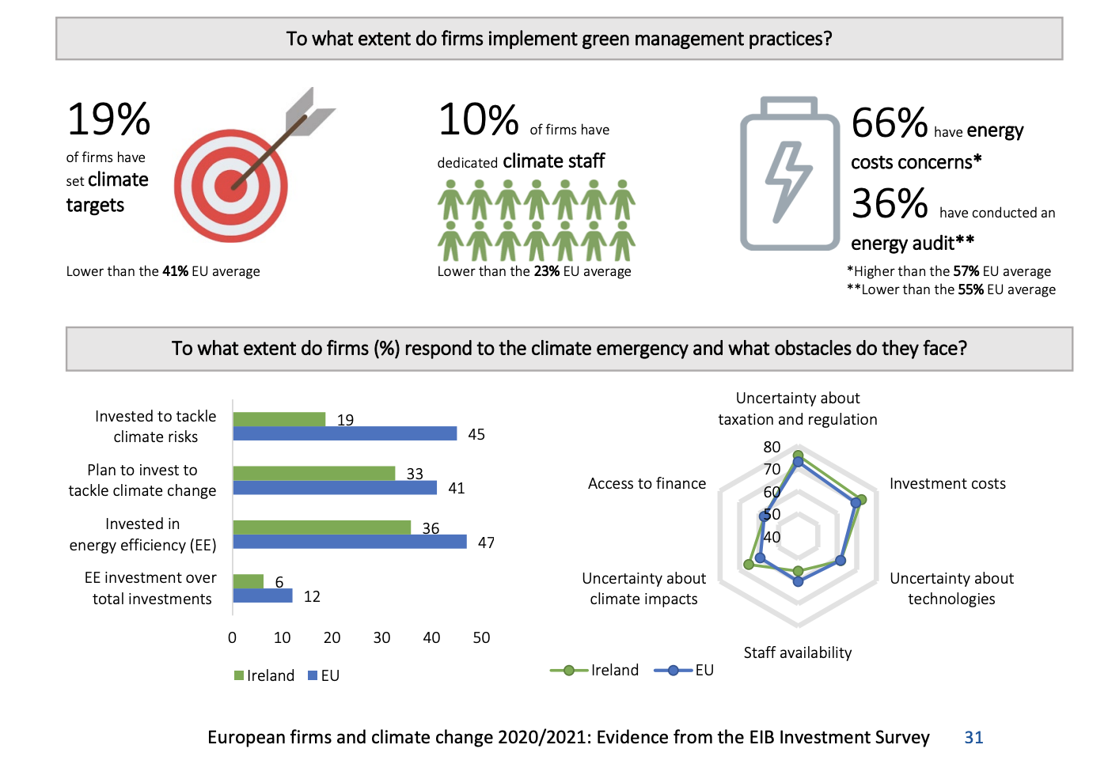

Slide 15
How can we deliver better on ESG?
1. Strategic
2. Operational
3. Asset - Level
The first step would be the development of your ESG Framework, which would be aligned with your company strategy.
This would provide us with a clearer set of goals and initiatives which may be targeted
Identify clear targets for 2030 and beyond, but make sure they are costed and understood.
The next stage would include a gap analysis of the workflows and documentation which underpins the existing business model.
The output would be updated processes and documentation based on ESG KPIs.
This may include the development of your ESG investment screening process
Set Net-Zero design principles for new construction and monitor delivery more rigorously.
For existing assets, perform energy audits, improve data quality, reduce consumption and create a net zero pathway for each asset
Create a model for investment and divestment decisions.

Slide 16
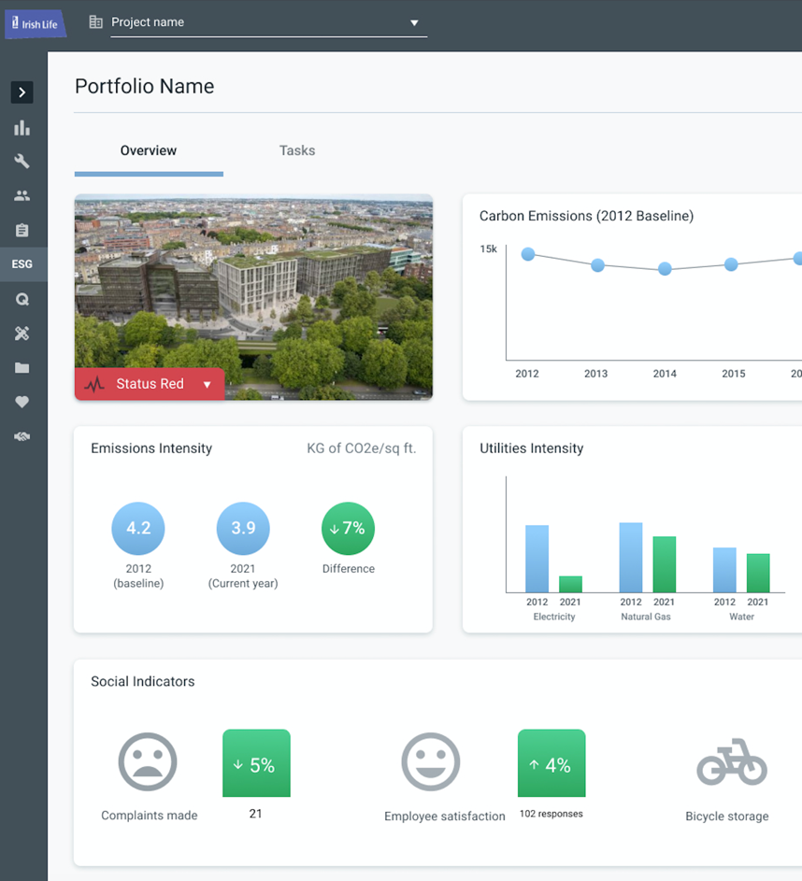
Summary
Our industry faces several challenges in the race to net zero.
Due to the interdependencies between ESG, finance, risk management and asset management these challenges cannot be tackled in a siloed manner.
They must be dealt with holistically in order to avoid unintended consequences.
The industry needs bold leadership and mistakes may be made, but I believe that they will be less costly than the mistakes of the past.
Real, meaningful data and evidence of due diligence is needed to deliver this change.
It is not enough to “talk the talk”. FMPs, Funds, Asset Managers, Developers and the wider value chain need to “walk the walk”
Those who make false declarations and/or fail to capture evidence of compliance will be subject to audit in the future.
The market will become more sophisticated at unearthing bad actors.
There is no “do nothing” scenario.
We can and must do better and there is no time to waste.

Slide 18
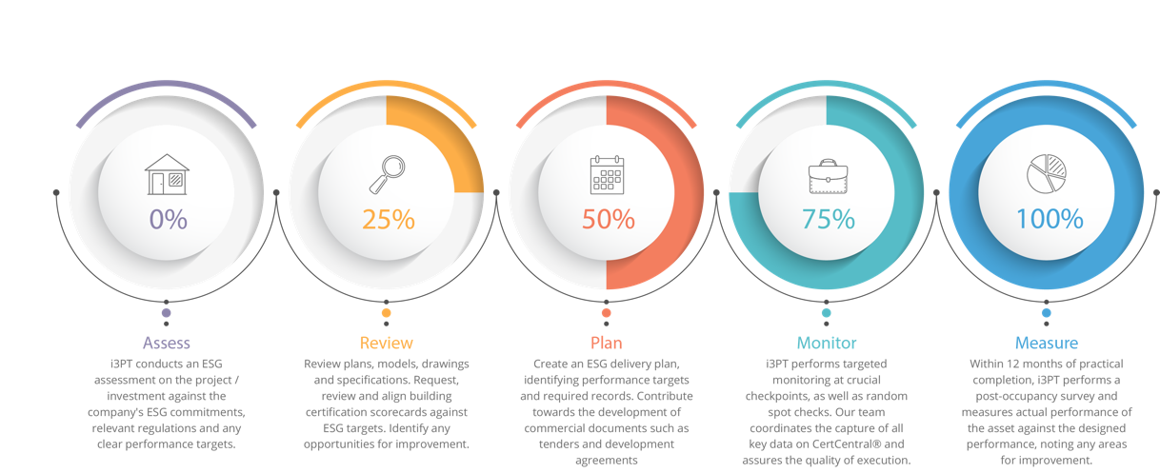
Our 5-step ESG Process at Asset Level

